Slide 1
Opening Term Deposit
Improving return from bank marketing campaign
Technical Presentation

Slide 2
Problem
We need to improve the return ratio from calls.
Return ratio from calls

Slide 3
First, we will load and transform and visualize it
In this step, we will reapply feature engineering and see how it improves the score
The last step is to send the model to IBM Watson to production
ETL
MODEL DEF
FEAT REENG
VALIDATION
PRODUCTION
The next step, we will use grid search to find the best model and hparams
Using the Recall-Score as metric, this steps validates the model

Slide 4
ETL
Dataframe
Data Visualization
Feature Engineering
We will save the data on a Pandas Dataframe. The data is not big enough to justify the use of a Spark Cluster.
To visualize the data, we will use matplotlib and SeaBorn.
The only engineering made in the first version was to apply encoding on categorical data. We will compare later with feature selection and PCA.
1. https://truecaller.blog/2019/12/03/truecaller-insights-top-20-countries-affected-by-spam-calls-sms-in-2019/

Slide 5
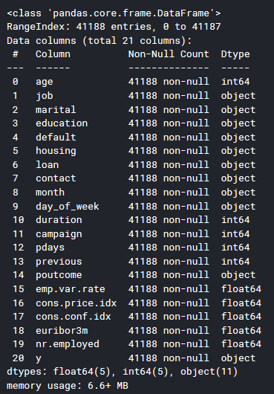

Slide 6
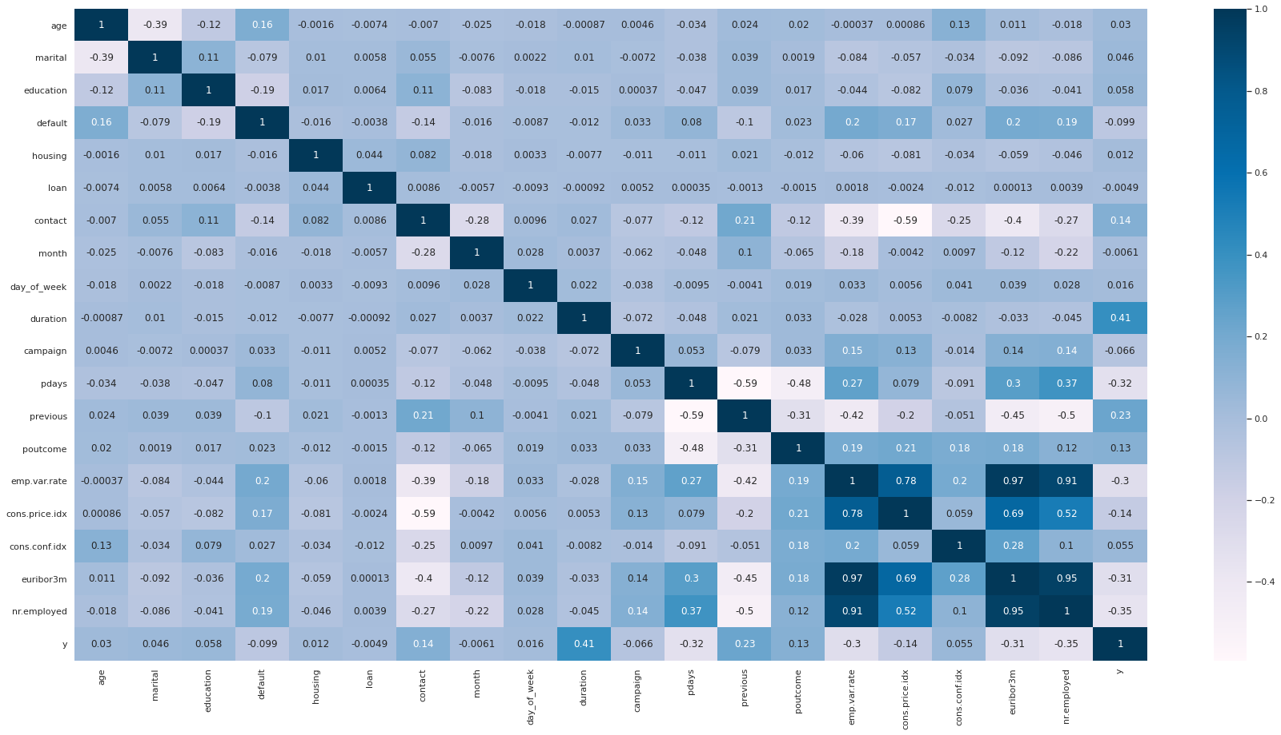

Slide 7
Data Visualization
Our target variable has high correlation with some features. Let’s take a look on them.
Let’s know our data a little more

Slide 8
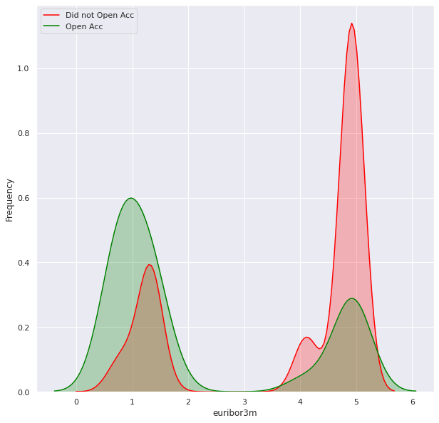
euribor3m vs 'y'

Slide 9
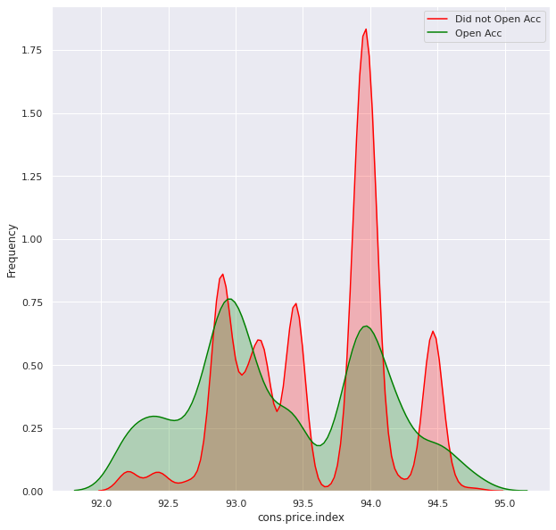
cons.price.idx vs 'y'

Slide 10
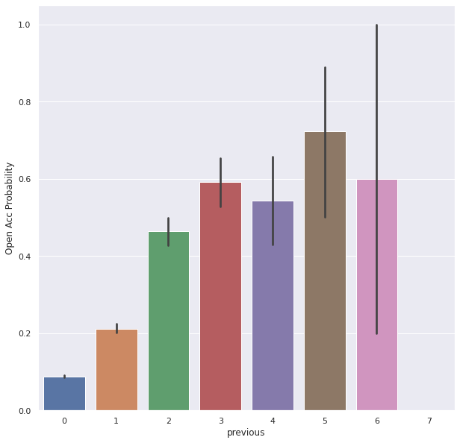
previous vs 'y'

Slide 11
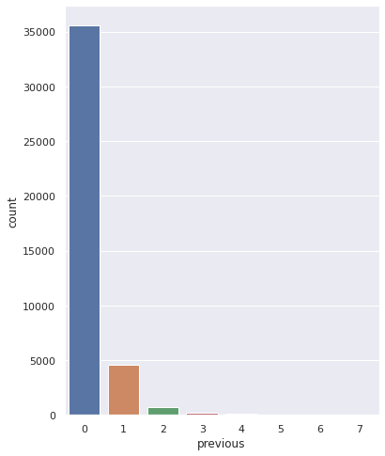
previous vs 'y'

Slide 12
Define a Model
To tune the hparams, we used GridSearchCV. After all the training and tuning, Adaboost was selected based on the Recall-Score.
We tried different classifiers: AdaBoosting, MLP, GradientBoosting, and ExtraTrees

Slide 13
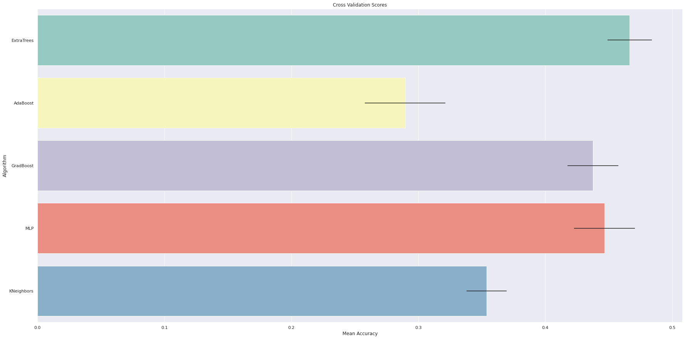

Slide 14
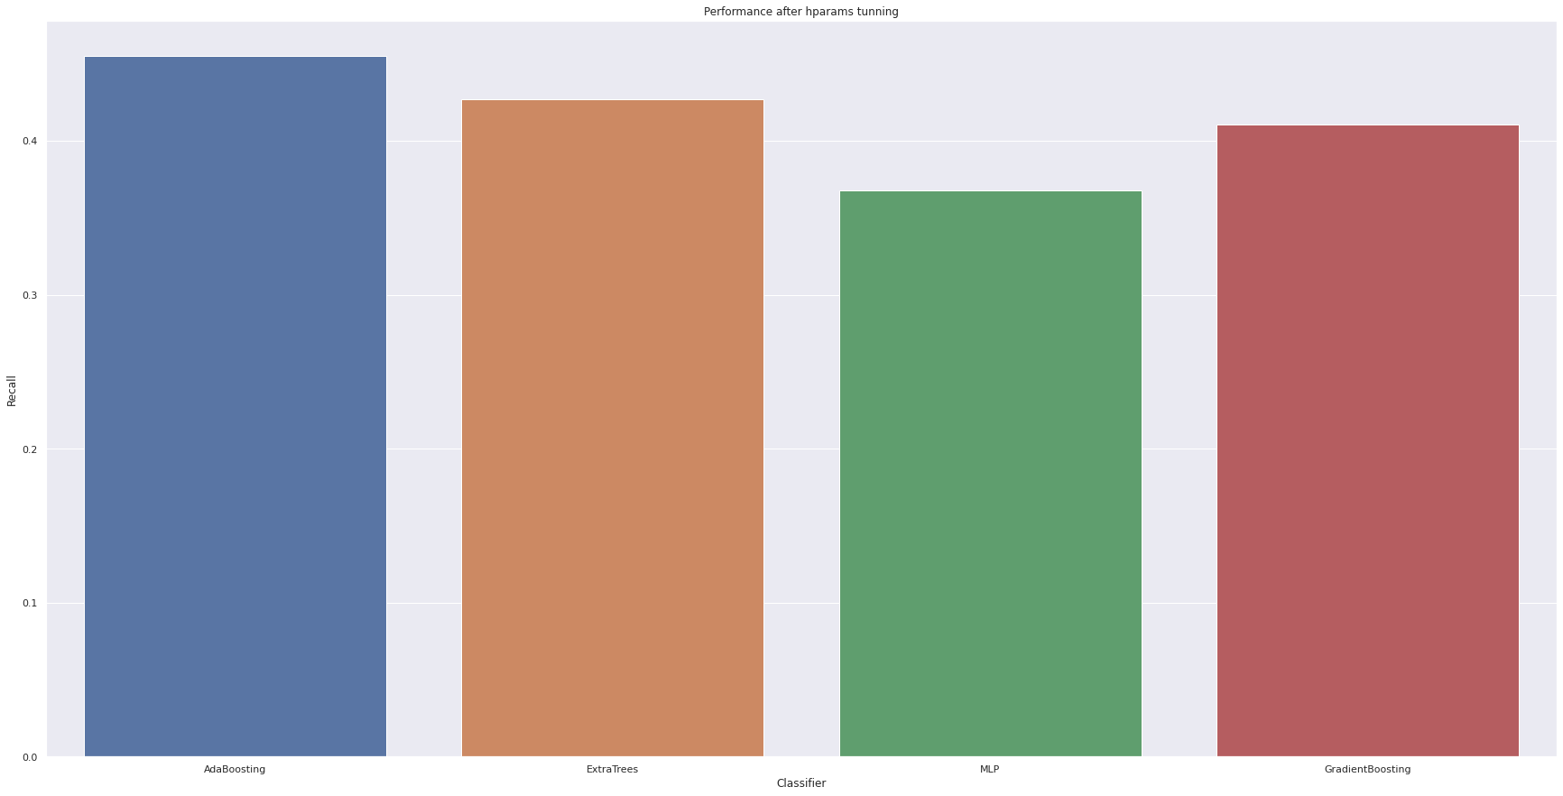

Slide 15
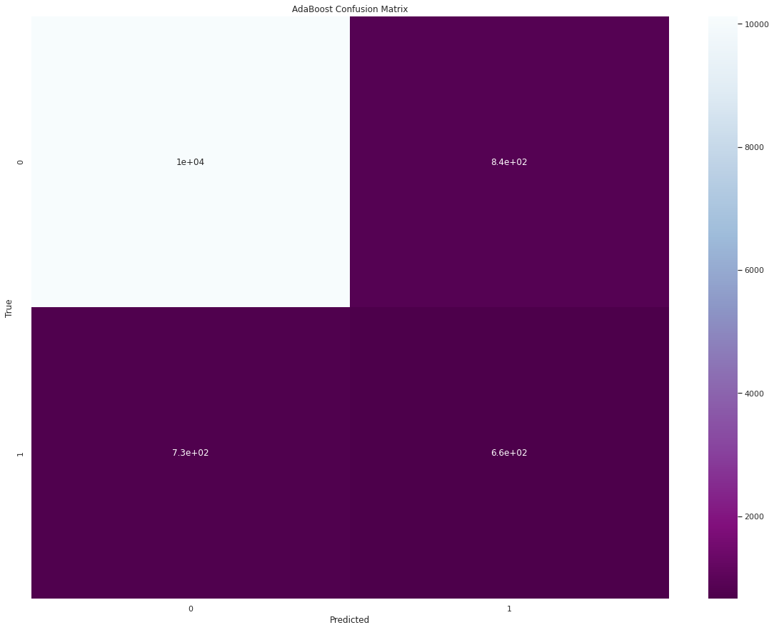
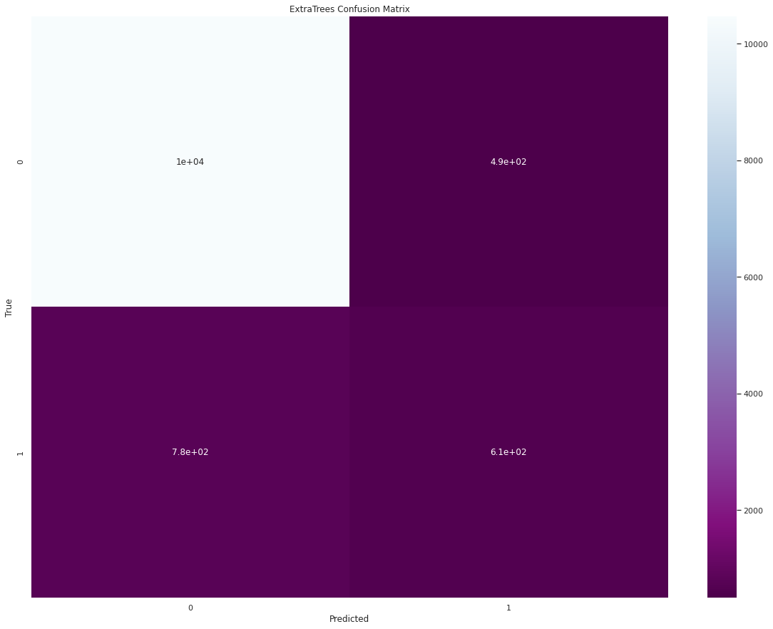


Slide 16
Feature Re-Engineering
In this step, we apply feature selection and PCA. PCA did not help, but with feature selection we improved the results.
We can make the model even better by apply some engineering.

Slide 17
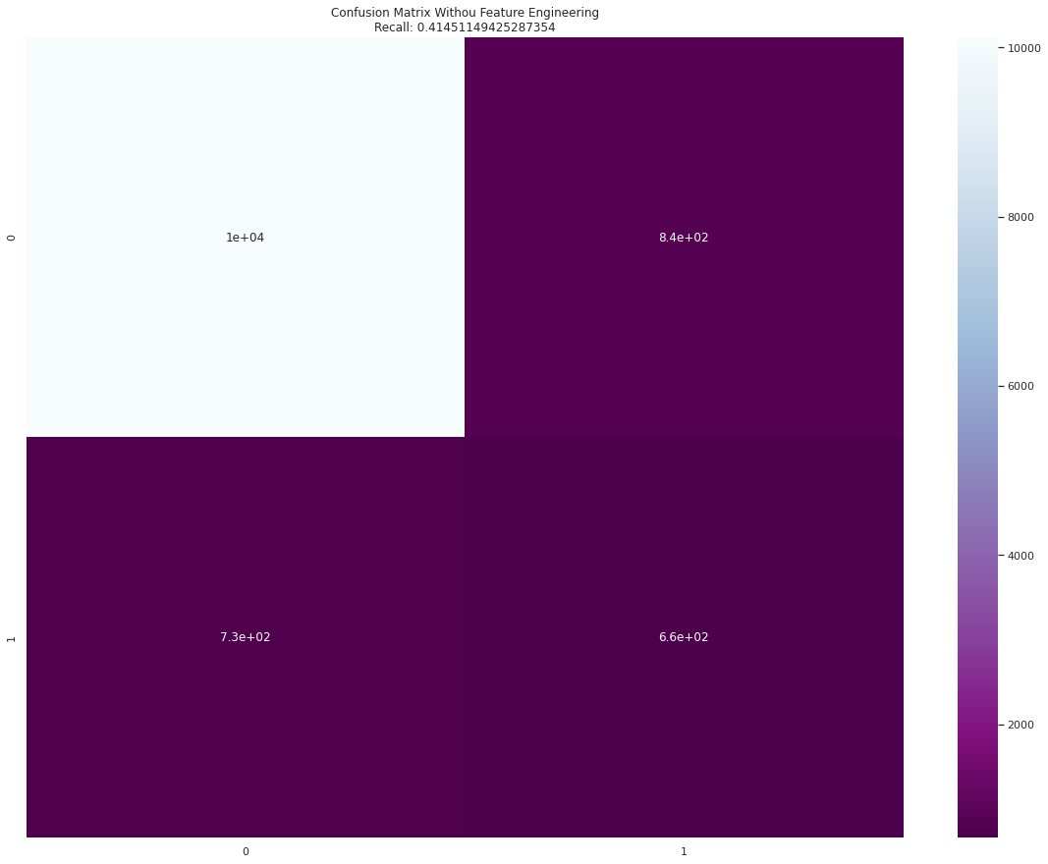
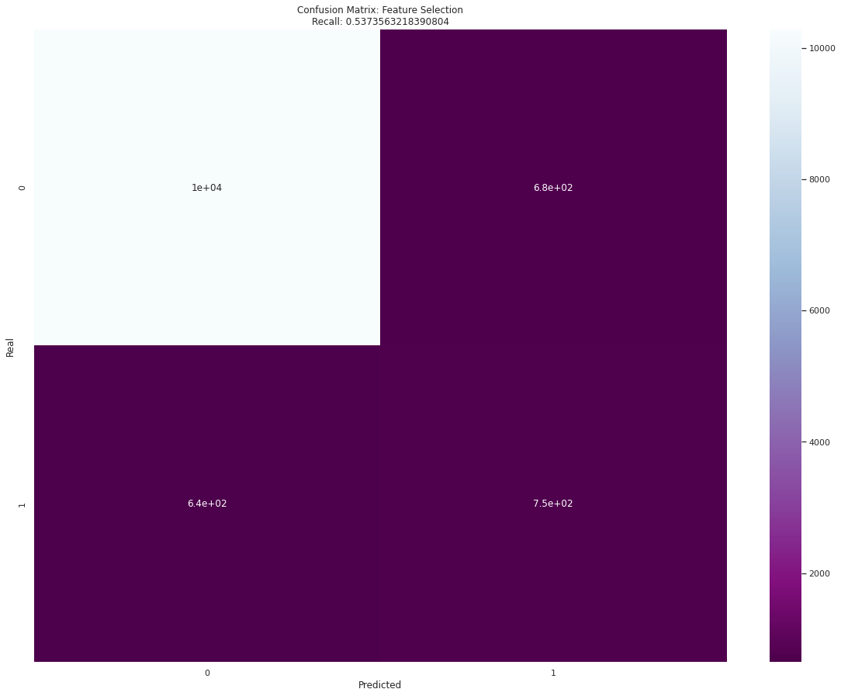

Slide 18
Conclusion
Applying our model, the bank will save money by reducing the number of calls and the number of people doing calls and will increase the return ratio from each one.
Efficiency

